Slide 1
Eastern Equine Encephalitis: 2019
Outbreak or Outlier
David Chung
NSS Data Analytics Cohort 1

Slide 2
Eastern Equine Encephalitis (EEE)
EEE virus is a rare cause of brain infections (encephalitis).
Only a few cases are reported in the United States each year.
Approximately 30% of people with EEE die and many survivors have
ongoing neurologic problems.

Slide 3



Eastern Equine Encephalitis Transmission Cycle
vector
reservoir
reservoir
vector
Bridge Vector

Slide 4
Human EEE cases in US 2019
Notes:
the highest number of cases reported in more than half a century

Slide 5
Comparison of EEE cases between 2019 and 2009-2018

Slide 6
Top 5 States of Human EEE cases in 2019
Massachusetts
Michigan
New Jersey
Connecticut
Rhode Island
Notes:
1.Massachusetts
2. Michigan
3. New Jersey
4. Connecticut
5. Rhode Island

Slide 7
Human EEE cases in 2019
Notes:
Human EEE cases tri state area and Michigan. 2019

Slide 8
What is the Link between Michigan and Massachusetts (Northeast States)?

Slide 9
Eastern Equine Encephalitis Transmission Cycle
vector
reservoir
reservoir
vector
Bridge Vector

Slide 10
EEEV Positive Mosquitoes in Massachusetts
Notes:
2018:2 positive one in Lakeville Plymouth county, Hubbardston
2017: Bristol , Westport county(2)
2016:Kingston,middleborough,west bridgewater,yarmouth(4)
2015:northbridge(1)
2014:Bristol county:14, Plymouth county 15 (33)
2012:267 positive mosquitoes
2011:80 positive mosquitoes

Slide 11
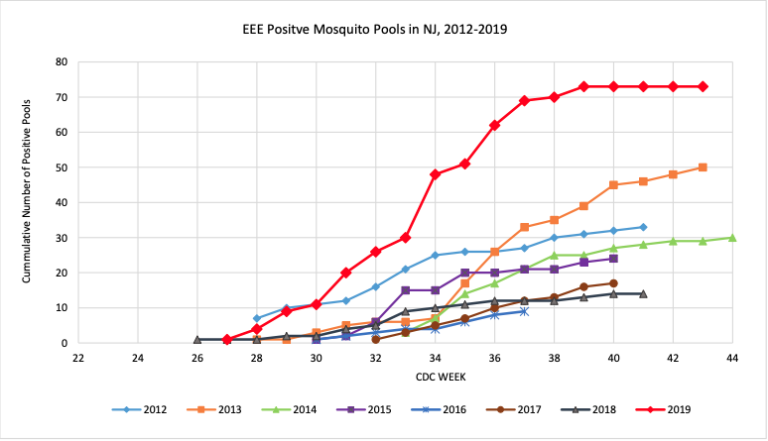
EEEV Positive Mosquitoes in New Jersey
New Jersey Health Dept.

Slide 12
Distribution of Positive mosquitoes by county and city
County
City
Notes:
2019: top two counties Bristol and Plymouth
2014: top two counties Bristol and plymouth

Slide 13
EEEV positive mosquitoes in 2019

Slide 14
Factors influencing mosquito population
Precipitation: Many mosquito species experience an increase in larval habitat availability
due to increased precipitation
Temperature: Killing frost is defined as two consecutive hours at a temperature below 28
degrees Fahrenheit
Notes:
Question: Did Michigan and Massachusetts(northeast states) have similar climate leading up to 2019 outbreak?

Slide 15
Precipitation and EEEV Human Cases in Plymouth County (MA)
Notes:
Fall precipitation sept –November, Mosquito lay their eggs in water , lay eggs in fall for before shutting down for winter.

Slide 16
Killing frost days and EEEV human Cases
Killing Frost Days
Notes:
Total days of hard freeze leading up to respective summer and corresponding EEEV cases that summer.
Looking at mosquito weather data. 2012 seems local but 2019 seems regional. Why.

Slide 17
2012: High precipitation & Low Kill frost days -> Possibility of Increased Mosquito population -> 7 EEE Cases
2019: High precipitation & Average Kill frost days -> 12 EEE Cases?

Slide 18
Distribution of EEEV Positive Animals and Humans in Michigan
Notes:
file:///Users/davidchung/Desktop/DataAnalyticsFile/capstone/mich_pos_county_heatmap.html

Slide 19
Precipitation and Human EEEV Cases in Michigan
Notes:
Michigan precip and eee cases, no correlation at all

Slide 20
Killing frost days and human EEEV in Michigan
Notes:
Killing frost days and EEE cases, no correlation

Slide 21
What is the Link between Michigan and Massachusetts (Northeast States)?

Slide 22
Eastern Equine Encephalitis Transmission Cycle
vector
reservoir
reservoir
vector
Bridge Vector

Slide 23
Birds are known to be reservoirs for vector borne diseases ( i.e. WNV)
EEEV Infected wild birds are mostly asymptomatic but have high viral load such that mosquitoes that feed on them can transmit the virus.
Analyze Migratory birds and Permanent Resident birds
Notes:
Focus on birds, migratory birds could possibly link the two states Michigan, massachusetts

Slide 24
Migratory Birds
EEEV infection in animals all year round in Florida
Analyze EEEV surveillance data (sentinel chicken data)
If Migratory Birds are the source of EEEV, most likely would also see High incidences in Southern States
Birdcanada.com
University of Florida

Slide 25
EEEV activity in Florida
Notes:
EEEV surveillance in Florida, do not see any spike in 2018, or 2019 so not migratory birds. Not from florida
Migratory birds that do not originate from florida. Migratory bird that migrate to Midwest and northeast because if it was resident birds no chance of both mass and mich.

Slide 26
Which bird species is a carrier for EEEV?
Method: EEEV Sampling of 997 wild birds 54 species, 44 states,
collected from 1/1/2013-9/30/2013, tested for antibodies

Slide 27
Next: Analyzed bird Migratory Path and Population distribution that carried EEEV in the study

Slide 28
Distribution of Mute Swan Population
Human EEE cases in 2019
www.audobon.org
Notes:
EEEV and mute swan distribution.

Slide 29
EEEV positive mosquitoes in 2019
EEEV positive mosquitoes & Mute Swan population distribution in Massachusetts
Mute Swan Distribution (2019)

Slide 30
EEEV positive mosquitoes & Mute Swan population distribution in Massachusetts
Notes:
Overlay of EEEV positive heatmap with mute swan population distribution.

Slide 31
EEEV positive animals & Mute Swan population distribution in Michigan
EEEV Positive Animals and Humans (2019)
Mute Swan Population (2019)

Slide 32
EEEV positive animals & Mute Swan population distribution in Michigan

Slide 33
EEEV positive Mosquitoes & Mute Swan population distribution in New York
EEEV positive Mosquitoes and Animals (2019)
Mute Swan Population Distribution (2019)

Slide 34
Conclusion
Increased incidences of EEE cases in 2019 in Michigan and Massachusetts (northeast states) could possibly be linked to Mute Swans.
There is a possibility an outbreak of EEEV among the Mute Swan population and as a result, EEEV is ‘spilling over’ to humans.
Further studies needed to confirm findings.

Slide 35
Data Sources
EEE Data: CDC (Center for Disease Control and Prevention)
Weather Data :NOAA (National Oceanic and Atmospheric Administration)
Mosquito Data: Massachusetts Health Department
Michigan Health Department
New York Health Department
Florida Health Department
Mute Swan Data: GBIF (Global Biodiversity Information Facility)

